Slide 1
Contemporary Teaching and Learning
St John Vianney’s School, Manly

Slide 2
Notes:
On our signage as you enter the CSO it talks about faith in their future – I would like to think of it in terms of faith in our future
Should not have to apologise for being a small diocese – our size is our strength

Slide 3
Agenda
Why have a 1 to 1 Laptop Program?
What is happening in other schools?
What is our proposal?
Questions / Parent Response

Slide 4
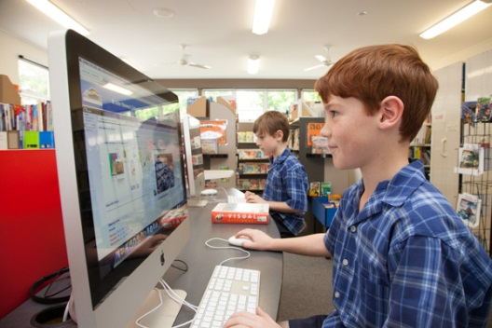
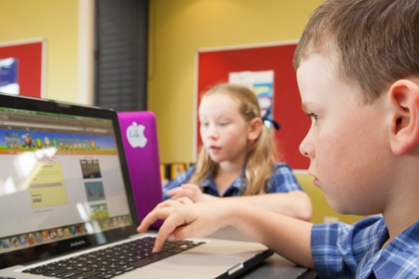
Contemporary Teaching & Learning
21st century education integrates technologies, engaging students in ways not previously possible, creating new learning and teaching possibilities, enhancing achievement and extending interactions with local and global communities.

Slide 5
Contemporary Teaching & Learning
The school has a vision to establish an learning environment that will:
excite and motivate students;
promote independent and flexible learning;
be sustainable and affordable;
enhance and improve learning and teaching to be relevant and engaging;
integrate different technologies into the everyday classroom experience.

Slide 6
Contemporary Teaching & Learning
The introduction of the 1:1 MacBook Program is a key initiative that will help us achieve this vision. The 1:1 MacBook program starts a new phase in education at our school. It offers the potential to have a deep impact on our students' education, and the learning process. Experience in our own trial of MacBooks at our school shows that students are quick to adopt new technology, and most will have little difficulty learning their way around their MacBook.

Slide 8
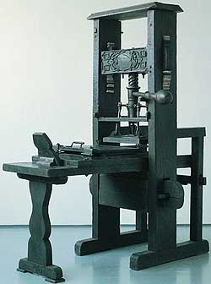
3 biggest paradigm shifts in the world
4th Century
Alphabet Literacy
15th Century
Printing Press
20th Century
Digital Technology

Slide 9
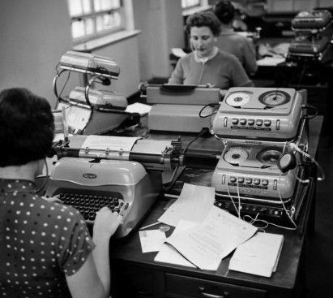
What sort of world were students prepared for?
What knowledge & skills were required to be successful?

Slide 10
My name is Rani and I am six years old.
I might live to see the next century; my children surely will
The jobs I will do haven’t been invented yet
Next year I will start school
Do you know what I need to learn?
Do you know what to teach me?
Do you know how to teach me?
Will you be able to equip me to live in my world?

Slide 11
Hello, my name is Adam. I am five today.
Education that:
is forward looking;
is focused on better teaching and learning;
promotes new skills, literacy and creativity;
is connected to a wider community and
prepares students for the world they live in

Slide 12
20th Century Learning | 21st Century Learning
One-size Fits all | Personalised
Competitive | Collaborative
Classroom | Global Community
Text-based | Web based
Learning for School | Learning for life
Passive Learning | Feedback is specific / relevant & timely

Slide 13
Technology merely a
Tool for Learning
curriculum
drives
technology

Slide 14
Goal 1: Australian schooling promotes equity and excellence.
Goal 2: All young Australians become successful learners, confident and creative individuals, active and informed citizens.
Notes:
Australian Curriculum – high aspirations for young people in this country as seen through the Educational Goals for young Australians in the Melbourne Declaration.
The Australian Curriculum outlines WHAT it is important for all young Australians to learn – their learning entitlement – they are entitled to learn it. The General Capabilities are part of the Australian Curriculum therefore they are part of the learning entitlement for each student.

Slide 15
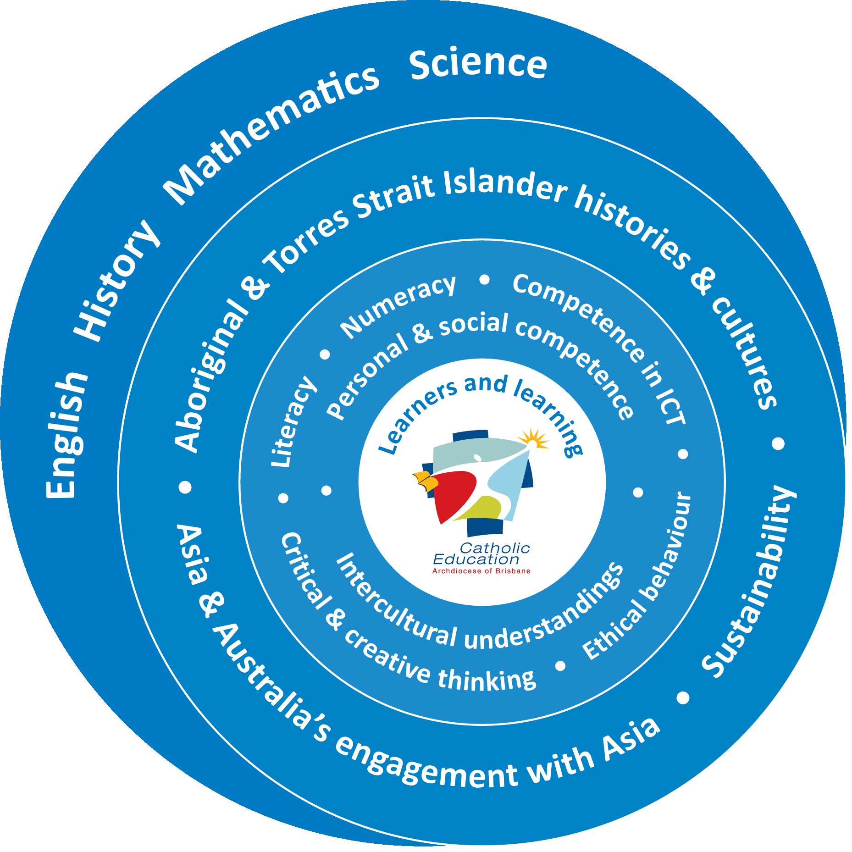
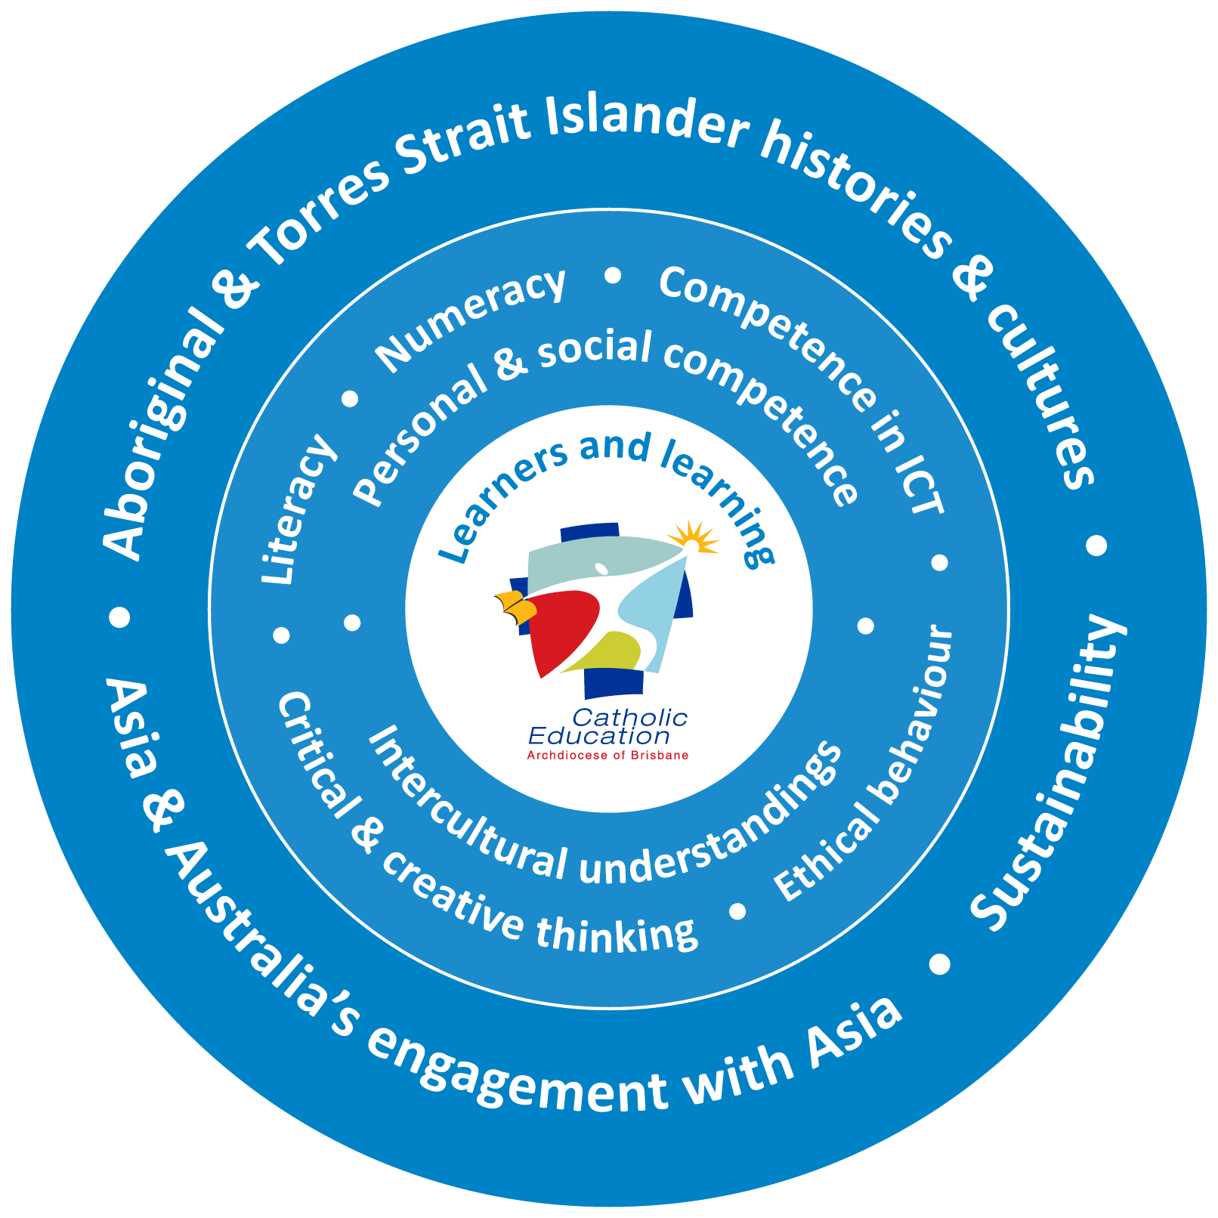
Learning areas: The level statements, content descriptions and standards guide what students learn and achieve in English, History, Mathematics and Science.
Cross-Curriculum Priorities:
Students develop these perspectives in learning and living with increasing sophistication across P to 12.
General Capabilities: Students develop these capabilities in learning and living with increasing sophistication across P to 12.
Learners and learning; Teachers and teaching:
Melbourne Declaration:
Goal 1: Australian schooling promotes equity and excellence.
Goal 2: All young Australians become successful learners, confident and creative individuals, active and informed citizens.

Slide 16
When 1:1...What the research tells us…
Student attendance increases and students are more motivated and more engaged (Russell, 2004, New Brunswick, 2004-06)
Students write more, more often and better. (Silvernail, 2004, Warschauer, 2005)
Overall improvement in test scores (New Brunswick, 2004-06 +)
Students engagement in critical thinking, problem-solving, and higher-order thinking on a task increased with 1-to-1 students; more willing to address/assess controversy within an assignment (Rockman, 1998)

Slide 17
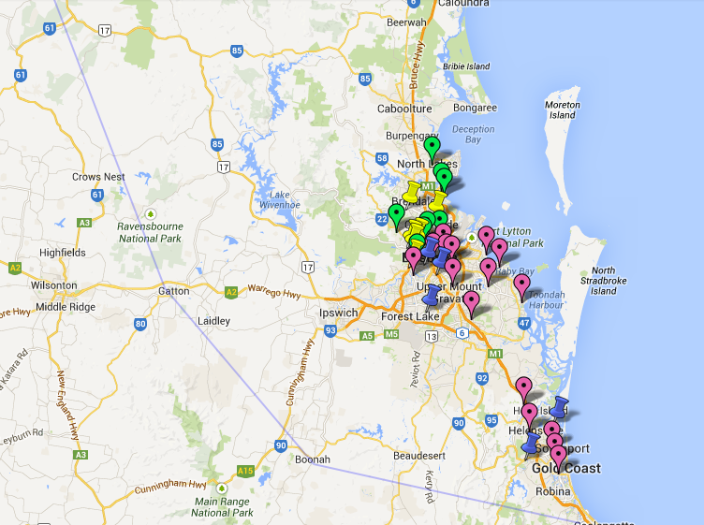
Brisbane Catholic Education 1-1 Context…

Slide 18
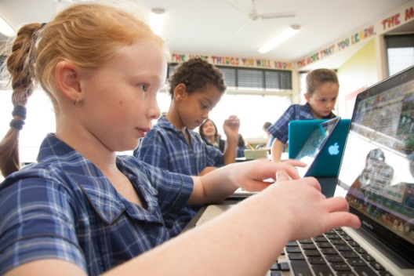
What is a one to one laptop program?
A one to one laptop program:
provides every student with access to his/her own laptop computer in a wireless environment allowing students to learn at their own pace and ability levels.
is the next step from occasional and supplemental use of ICLT technology to more frequent and meaningful use.

Slide 19
What would a one to one laptop program look like in the classroom?
A one to one laptop program complements the existing school curriculum by providing appropriate digital learning tools in balance with more traditional learning tools.
The program also increases the teacher’s pedagogical capacity by “adding tools to the toolkit.”

Slide 20
What would the one to one laptop program look like in the classroom? (continued)
The use of the laptop would vary from day to day depending on the requirements of the learning program for the day.
There would be increased levels of collaboration between students when using the laptops.
.

Slide 21
What would the one to one laptop program look like in the classroom? (continued)
Students would be able to access and use their school files at home and collaborate with their peers on projects through the secure BCE Student Portal.
The goals of the curriculum would be supported, not replaced, by the use of one to one laptops. Students will use 1-to-1 devices where they serve a purpose.

Slide 22
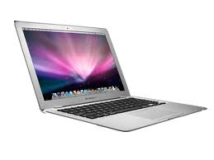
Proposed Device
MacBook Air
11.6-inch high-resolution LED-backlit glossy widescreen
64GB flash storage
1.7GHz dual-core Intel Core i5 Processor
4GB of 1600MHz DDR3L onboard memory
Size and Weight
1.08 kg
Stereo speakers
Omnidirectional microphone
Headphone port
Multi-Touch trackpad
Up to 5 hours wireless web
3 Year warranty
3 year Apple Support

Slide 23
Software – BCE Image
Mac OS X Lion 10.7.2
iLife ’11 (iPhoto ‘11, iMovie ‘11, GarageBand ’11)
Microsoft Office 2011
Sophos Anti-Virus 7.3
Microsoft Messenger
Adobe Flash Player
Microsoft Silverlight
Citrix Receiver
Built-in recovery partition

Slide 24
The Package Includes:
Laptop and power supply
Software
Applecare Protection Plan
(Provides Home Support)
3 year warranty
Insurance (accidental and theft)
Bag
Identification Skin

Slide 25
Are the computers covered by insurance for damage?
Each device will be covered by an Accidental Damage Program for accidental damage caused at school.
If damage is due to negligence, carelessness or wilful damage, an excess fee of $150 will be payable to the school by the child’s parents/guardians.
Repeat incidents of damage will attract an escalating excess, at the discretion of the Principal.

Slide 26
Insurance - Loss or Theft
The laptops will be insured by the school for loss or theft.
The school is to be notified immediately if there is a problem with loss or theft of a laptop. (No later than 24 hours after the event. A Queensland Police Reference Number should accompany this notification.)
An excess fee will apply depending on circumstances.

Slide 27
Cost of the Program
The total cost of the program includes the following:
Laptop
Apple Care Protection Plan
Technical Support
Accidental Damage Care Pack
Loss or Theft
Software Package – BCE Image
Bag & Protective Skin with User Identification Details
NB This is a lease arrangement and parents/students do not own these devices at the end of the period.
Yearly | Term x 3 | Day
$330 | $110 | Less than $1.00

Slide 28
Some Questions
What if I don’t want my child to participate in the program?
Your child won’t have one to one access of a laptop, but will be able to use one of the school’s laptops when at school.
How does a student participate if they do not have a computer?
Students will be given access to a computer, which might or might not be located in their current classroom. These computers will not be able to be taken home.
Can students bring their own devices from home instead?
Home devices are not configured to the school network, can be a source of viruses and are often not enabled with the licensed software. Home devices are not licensed to use the school image and maintenance issues will be more difficult and may not be resolved in an appropriate time frame. Insurance issues also present difficulties. Therefore, laptops from home may not be brought to school.

Slide 29
Support Systems
Although the Apple laptop is robust and reliable, the reality is that sometimes things will go wrong. The school will have a few spare laptops that will be swapped in and out of service when a computer requires repair. This means that a student will have access to a computer at all times, unless there are unexpected multiple faults.

Slide 30
What’s next?

